Slide 1
BUILDING CONSTRUCTION I LECTURE 3 CONSTRUCTION REQUIREMENTS AND SITE PREPARATION

Slide 2
INTRODUCTION
General building construction requirements encompass a range of standards and guidelines that ensure safety, functionality, and compliance with local regulations. These requirements can be categorized into General Conditions and General Requirements, each addressing different aspects of construction..
General Conditions
General Conditions are contractual stipulations that outline the responsibilities and procedures for managing a construction project. Key components include:
Project Administration: Defines the roles of stakeholders (owners, contractors, architects) and the decision-making process.

Slide 3
General condition cont..
Project Schedule: Specifies timelines for project milestones, including start and completion dates.
Payment Terms: Details the structure of payments, including progress payments and conditions for withholding payments.
Insurance and Bonding: Requires contractors to maintain specific insurance levels to protect against liabilities.
Dispute Resolution: Establishes methods for resolving conflicts, often through mediation or arbitration.
Changes and Modifications: Outlines how changes to project scope will be managed

Slide 4
General Requirements
General Requirements focus on the technical aspects of construction. They are typically found in technical specifications and include:
Materials and Equipment: Specifies the quality and type of materials to ensure consistency and safety.
Workmanship Standards: Sets expectations for craftsmanship, including acceptable tolerances.
Permits and Inspections: Outlines necessary permits and inspections to comply with building codes.
Safety and Environmental Compliance: Emphasizes safety protocols to protect workers and the environment during construction.
Testing and Quality Assurance: Includes provisions for material testing to ensure compliance with standards.
Site Conditions: Addresses specific site-related issues like drainage, utilities, and unique challenges

Slide 5
Specific Building Requirements
In addition to general conditions and requirements, specific building elements must meet established standards. These may include:
Room Dimensions: For example, habitable rooms must have a minimum height of 2.75 meters, while bathrooms should have a height of at least 2.1 meters
Accessibility Standards: Buildings must be designed to be accessible to individuals with disabilities.
Fire Safety Regulations: Fire resistance requirements vary based on building occupancy classifications.
Structural Integrity: Foundations must be adequately designed to support the building's load while ensuring proper drainage.

Slide 6
SITE PREPARATION
Site preparation is a critical phase in construction that involves a series of steps to ensure the site is ready for building. This process not only lays the groundwork for the construction but also ensures safety and compliance with regulations. Below are the essential aspects of site preparation, including the steps involved and factors to consider.
Key Steps in Site Preparation
Site Clearing: The first step involves removing any vegetation, debris, or existing structures from the site. Heavy machinery like bulldozers and excavators are typically used for this purpose

Slide 7
Key Steps in Site Preparation Cont..
2. Site Surveying: A thorough survey of the land is conducted to determine its boundaries, topography, and any existing utilities. This step is crucial for zoning and obtaining necessary permits.
3. Soil Testing: Soil testing assesses the composition and stability of the ground to determine its suitability for construction. This includes checking for soil type, bearing capacity, and potential issues like liquefaction.

Slide 8
Key Steps in Site Preparation Cont..
4.Site Design Planning: Based on the survey and soil test results, a detailed site plan is developed. This plan outlines where structures will be placed, drainage systems, and access points for vehicles and personnel
5.Excavation: Excavation involves digging to create foundations or basements as required by the project. This step also includes preparing space for drainage systems
6. Grading and Soil Compaction: Grading levels the ground to provide a stable base for construction, while compaction reduces pore space in the soil to enhance stability and prevent future settling issues
7. Drainage Installation: Proper drainage systems are installed to manage water runoff and prevent erosion during and after construction. This includes features like silt fences and retention ponds

Slide 9
Factors influencing Site Preparation
Nature of the Project: Different types of construction (residential vs. commercial) require varying levels of preparation.
Project Size: Larger projects typically necessitate more extensive site preparation efforts.
Location: Urban sites may face unique challenges such as limited space or existing infrastructure that must be navigated during preparation

Slide 10
Importance of Site Preparation
Effective site preparation is essential for several reasons:
It enhances safety by removing hazards before construction begins.
Properly prepared sites reduce environmental impact through effective erosion control measures.
A well-prepared site can lead to more efficient construction processes, minimizing delays and costs associated with unforeseen complications

Slide 11
CLEARING TERMITES
Termites pose a great danger because they eat cellulose in timber in building where they can not be seen. Destruction is often well advanced before it becomes obvious on the surface, Hence, termites nests should be dug out and contents destroyed.
SITE LEVELLING
The operation of site levelling is done by combination of manual and mechanical method. Levelling involves bringing the land surface to a common levelled surface before the setting out of the building begins. The soil is removed to a reduced level. The process of levelling the sites involves;

Slide 12
Cut and fill. This means, high area of the soil are cut and the lower areas within the site are filled up.
Cut : This method has the advantage of giving undisturbed soil over the whole of the site but has the disadvantage of the cost of removing the spoil from the site.
Fill only: A method not recommended because if the building is sited on the filled area, either deep foundation would be needed or the risk of settlement at a later stage would have to be expected.
REMOVAL OF VEGETABLE SOIL ( TOP SOIL)
Top soil is removed from site due to the following reasons;
Contain decayed vegetable matter and plants which must be prevented from growing underneath the structure

Slide 13
REMOVAL OF VEGETABLE SOIL Cont….
It is weak and excessively expansible when loaded.
It is relative loose
It is weathered.
The top soil varies in thickness from 150mm to 230mm.All these can cause even settlement of the soil under the foundation and can result into cracks to the structure.

Slide 14
BUILDING SITE LAY OUT
A building site layout refers to the graphical representation of how the construction site will be arranged, including the positioning of structures, access routes, and temporary facilities.
This layout serves as a guide for construction, ensuring that all elements are correctly positioned according to design specifications and local regulations.

Slide 15
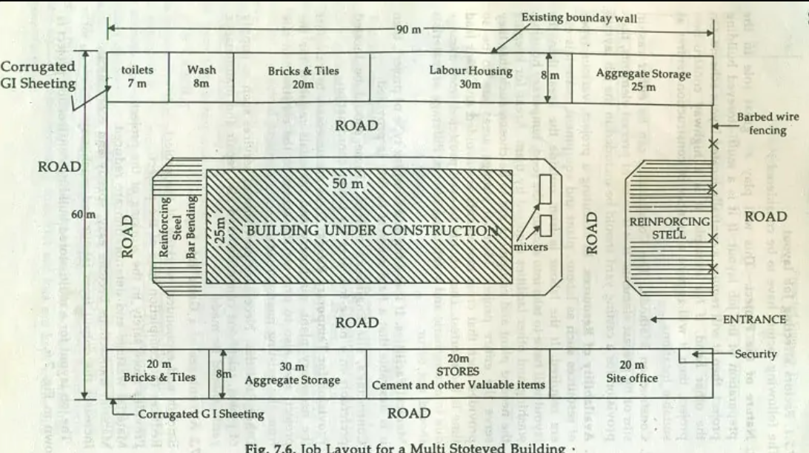
BUILDING SITE LAY OUT CONT..

Slide 16
BUILDING SITE LAY OUT CONT..
Importance of Site Layout
Efficiency: A well-planned layout minimizes travel time for workers and equipment, thereby enhancing productivity.
Safety: Proper site layouts help in complying with safety regulations, reducing the risk of accidents by ensuring clear access routes and emergency exits
Cost Management: Effective planning can lead to significant cost savings by preventing delays and minimizing waste during construction
Regulatory Compliance: Adhering to local zoning laws and building codes is essential to avoid legal issues

Slide 17
BUILDING SITE LAY OUT CONT..
Key Factors in Site Layout Planning
When planning a construction site layout, several critical factors must be considered:
Project Scope and Objectives: Clearly define the purpose and goals of the project to guide the layout design.
Site Accessibility: Ensure that there are adequate access points for vehicles and personnel to facilitate smooth operations
Safety Regulations: Incorporate safety measures into the layout, including emergency exits and first-aid stations.

Slide 18
Key Factors in Site Layout Planning cont..
Environmental Considerations: Assess potential environmental impacts and plan for erosion control and waste management.
Utility Infrastructure: Plan for the efficient installation of utilities such as water, electricity, and gas.
Site Topography: Consider the natural features of the land, including slopes and drainage patterns, which can affect construction methods

Slide 19
Steps for Creating a Building Site Layout
Define Project Objectives: Establish clear goals for what the project aims to achieve
Gather Site Information: Collect data on topography, soil conditions, existing utilities, and any legal constraints affecting the site.
Establish Control Points: Set up fixed reference points on-site that will serve as benchmarks for measurements
Draft the Layout Plan: Using design software or manual drafting, create a detailed plan that includes all necessary features such as buildings, access roads, storage areas, and utilities

Slide 20
Steps for Creating a Building Site Layout Cont…
Review and Adjust: Check for discrepancies between planned layouts and actual site conditions; make necessary adjustments before proceeding with construction
Maintain Documentation: Keep records of all layout plans and modifications throughout the project lifecycle to ensure clarity among all stakeholders

Slide 21
Tools and Techniques
Utilizing modern technology can enhance accuracy in site layout planning:
Surveying Instruments: Tools like total stations or GPS can help establish precise control points.
Site Management Software: These tools can automate aspects of layout planning, saving time and reducing errors
Manual Tools: Traditional tools such as chalk lines, levels, and plumb bobs remain essential for marking out areas accurately on-site.

Slide 22
BUILDING SETTING OUT
Setting out a building is a critical procedure in the construction process, involving the accurate transfer of design plans onto the construction site. This ensures that the building is positioned correctly according to architectural specifications.
Tools Required
Pegs: Used to mark corners and boundaries.
Profile Boards: To outline the perimeter of the building.
Ropes or Strings: For defining wall lines.
Nails: To secure ropes to profile boards.
Measuring Tape: For accurate measurements.
Hammer: For driving pegs into the ground.
Shovel: For excavation work.
Builder's Square: To check right angles.
Theodolite or Site Square: For precise angle measurements if needed

Slide 23
BUILDING SETTING OUT cont..
Basic Procedures for Building Setting Out
1. Preparation of the Site
Clear the Area: Remove any debris, vegetation, or obstructions from the site to ensure a clear working area
Survey the Site: Conduct a condition survey and desk study to understand the site’s characteristics and confirm that it is suitable for construction
2. Establishing Baselines and Control Points
Determine Baselines: Establish a straight reference line (baseline) that will be used to locate all corners of the building. This often coincides with property boundaries
Mark Control Points: Use known coordinates to mark important points such as corners and center lines on the ground, which will guide further layout work

Slide 24
Basic Procedures for Building Setting Out CONT..
3. Setting Out Corners
Use Profile Boards: Drive corner posts into the ground at each corner of the planned structure, typically using timber posts with nails to attach string lines for marking
Check Squareness: Employ the 3-4-5 triangle method to ensure that corners form right angles. Measure 3 meters along one side, 4 meters along another, and check that the diagonal measures 5 meters

Slide 25
Basic Procedures for Building Setting Out CONT..
4. Transferring Plan Information
Mark Wall Lines: Use ropes or strings tied between profile boards to define wall lines accurately. Mark these lines on the ground using dry lime or similar materials
Identify Foundation Points: Transfer measurements from architectural plans onto profile boards, marking foundation outlines and key structural points with nails
5. Final Checks and Adjustments
Verify Measurements: Double-check all measurements and alignments to ensure accuracy before excavation begins. This includes checking diagonals to confirm that all corners are correctly positioned

Slide 26
Basic Procedures for Building Setting Out CONT..
Adjust as Needed: If any discrepancies are found during checks, make necessary adjustments before proceeding with excavation
6. Excavation Preparation
Outline Excavation Areas: Use marked lines to guide excavation for foundations, ensuring that they are dug according to specified widths and depths as per plans
Marking Trenches: For trench excavations, outline positions using string lines or chalk to maintain accuracy throughout the digging process

Slide 27
BUILDING SETTING OUT cont..
Importance of Accurate Setting Out
Precision in Construction: Accurate setting out ensures that structural elements such as foundations, walls, and columns are placed correctly, aligning with approved designs.
Error Mitigation: By carefully transferring measurements from plans to site, the risk of errors that could lead to costly rework is significantly reduced
Compliance with Regulations: Proper setting out helps ensure that all construction adheres to safety standards and regulatory requirements, minimizing legal risks
Cost Efficiency: Accurate initial setup can prevent unexpected expenses related to misalignment or reconstruction efforts later in the project timeline

Slide 28
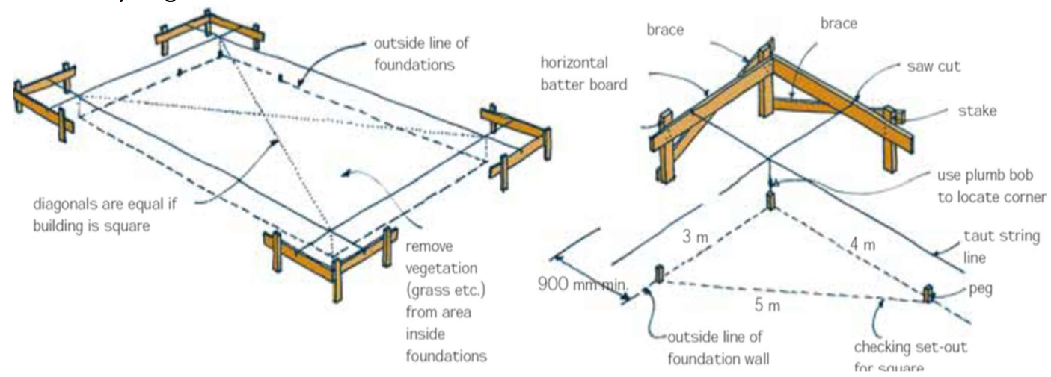
BUILDING SETTING OUT cont..

Slide 29
Exercise;

